Slide 1
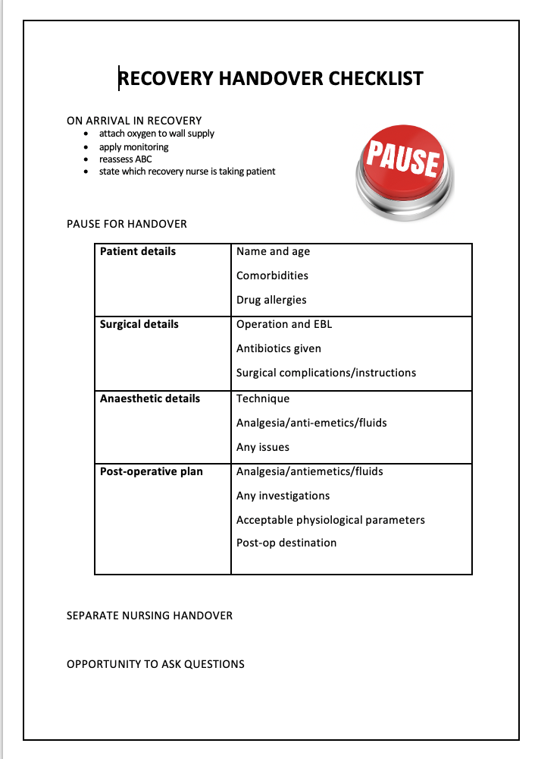
Improving handover in recovery
Litvack L¹ Wakefield A² R Martin² J Hearl² Chee L³
¹CT3 Anaesthetics ²Recovery Nurse ³Consultant Anaesthetist
Inverclyde Royal Hospital
Introduction
An anaesthetist's responsibility for patient safety continues into the recovery area where the patient remains at risk of surgical and anaesthetic complications.
The multi-disciplinary team is of vital importance, with recovery nurses taking a leading role in patient care. A clear handover between professionals should ensure continuity, quality and safety of patient care.[1]
The Royal College of Anaesthetists (RCoA) provide guidance about this handover.[2] They state that the handover should be distraction free, after the application of oxygen and monitoring.
Studies have shown that the use of checklists in anaesthesia can decrease human error, improve patient safety and teamwork, and increase quality of care. [3]
"Recovery handover checklist" (Figure 1) created and presented at anaesthetic departmental meeting along with survey comments and education on current guidelines. Checklist displayed on wall in every recovery bay. Four-month trial period using a distraction-free "pause" for handover and checklist as an aide-memoir
Second online questionnaire sent to all theatre staff with questions about impact of checklist and free text for suggestions and comments
Length of handovers timed after changes implemented
Figure 1: Recovery handover checklist
Results
The initial questionnaire received 20 respondents (7 recovery nurses, 5 anaesthetists, 6 anaesthetic nurses, 3 theatre nurses)
65% thought current handover was not adequate
55% thought not all relevant information was handed over
Distractions during handover we identified as a key issue:
85% simultaneous handover from theatre nurses/anaesthetist
60% application of monitoring
55% activity in the rest of recovery
The follow-up questionnaire received 38 respondents (10 recovery nurses, 7 anaesthetists, 10 anaesthetic nurses, 10 theatre nurses)
71% thought the ‘pause’ for handover had been useful
76% would be keen to continue with the ‘pause’
82% think that anaesthetists and theatre nurses are now not handing over at the same time
However 73% of recovery nurses think that staff are only sometimes waiting until oxygen and monitoring are connected before commencing the handover
There was no increase in average time for handover after the change (2 minutes 1 second vs 1 minute 53 seconds)
Aims
To evaluate the quality of handovers in the recovery area at Inverclyde Royal Hospital and identify how these may be improved.
To understand opinions on the handover process from all members of the multi-disciplinary team before and after implementation of any change.
Conclusion
Most of the multi-disciplinary team at our hospital have found the introduction of a distraction free "pause" and checklist for handover useful. This new handover process has not increased the length of time taken for handover.
However this process, is not always being followed. Further work should include promotion of the checklist
Thank you Dr L. Chee for her guidance in this project
Method
Ethics approval was not required
Online questionnaire sent to all theatre staff via Microsoft Forms with questions about the quality of the handover process in comparison to the RCoA guidelines and free text for suggestions and comments
Length of handovers timed without anaesthetist's knowledge before any change
References
Arora V et al. Jt Comm J Qual Patient Saf 2006; 32:646-655.
2. Royal College of Anaesthetists. Novice Guide 2019.
3. Saxena S et al. Anaesthes Crit Care Pain Med 2020; 39:65-73.

